Slide 1


THE VILLAGE of MAMARONECK POLICE DEPARTMENT
Uniform Crime Reporting
2024-2025

Slide 2

Uniform Crime Reporting
Uniform Crime Reports (UCR)
Law Enforcement Agencies across New York State provide the NYS Division of Criminal Justice Services (DCJS) with a report of all reported crimes that occurred within the jurisdiction on a monthly basis
The format of the report and crime definitions are determined by the FBI and DCJS ultimately submits these reports to the FBI which compiles national statistics
UCR is separated into 7 sections:
Section 1 Reported Part I Offenses
Section 2 Reported Part II Offenses
Section 3 Domestic Violence Victim Data
Section 4 Reported Homicide Detail
Section 5 Reported Arrests (18+)
Section 6 Reported Arrests (Under 18)
Section 7 Reported Hate Crime Detail

Slide 3
Uniform Crime Reports (UCR):
Part I and II definitions
Part I Offense: Considered to be Violent Crime (as defined by the FBI) and includes:
Murder
Negligent Manslaughter
Rape
Robbery
Aggravated Assault (typically involves a weapon)
Burglary
Larceny
Motor Vehicle Theft
In 2024 VMPD received 267 reported Part I Offenses
In 2025 VMPD received 118 reported Part I Offenses
55% Decrease

Slide 4
Uniform Crime Reports (UCR):
Part II Offense: Considered to be a “less” Violent Crime (as defined by the FBI)
Arson
Kidnapping
Controlled Substance Sale
Controlled Substance Possession
Dangerous Weapons (defined as “possession”)
Bribery
Sex Offenses
Extortion
Forgery & Counterfeiting
Prostitution
Patronizing Prostitutes
Stolen Property Possession
Coercion
Criminal Mischief
Fraud
Gambling
Offenses Against Public Order
Embezzlement
Simple Assault
Offenses Against Family
Driving Under the Influence (Alcohol & Drugs)
Unauthorized Use of Vehicle
Possession of Burglar Tools
Liquor Law Violations
Disorderly Conduct
Public Intoxication
Loitering
All other Offenses
In 2024 VMPD received 282 reported Part II Offenses
In 2025 VMPD received 205 reported Part II Offenses
27% Decrease

Slide 5
2024 UCR Part I Offenses (reported to VMPD)

Slide 6
2025 UCR Part I Offenses (reported to VMPD)

Slide 7
2024–2025 UCR Part I Offenses (reported to VMPD)

Slide 8
2024 UCR Part II Offenses (reported to VMPD)

Slide 9
2025 UCR Part II Offenses (reported to VMPD)

Slide 10
2024–2025 UCR Part II Offenses (reported to VMPD)

Slide 11
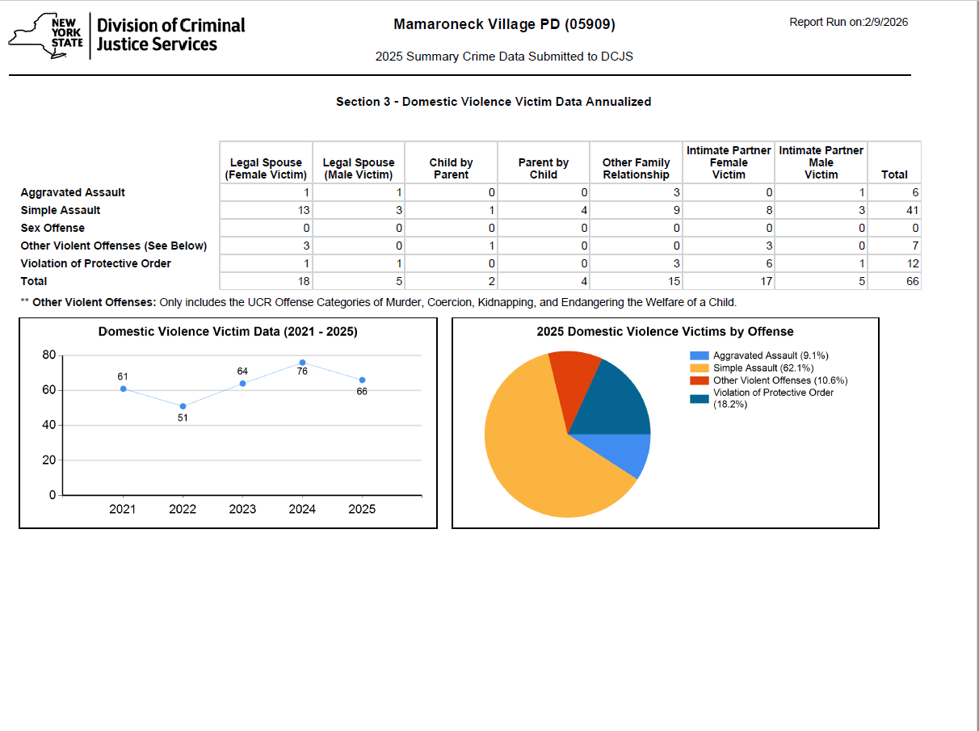
2024-2025 Domestic Violence Victim Data Annualized

Slide 12
2021 Reported Homicide Detail
*In 2025 VMPD did not have any reported homicides

Slide 13
2024-2025 Reported Arrests Part I & II Offenses (18+)

Slide 14
2024-2025 Reported Arrests Part I & II Offenses (under 18)
2024 Reported Arrests Part I &II (under 18) 6
2025 Reported Arrests Part I &II (under 18) 3

Slide 15
2024-2025 Reported Arrests Part I & II Offenses (under 18)

Slide 16
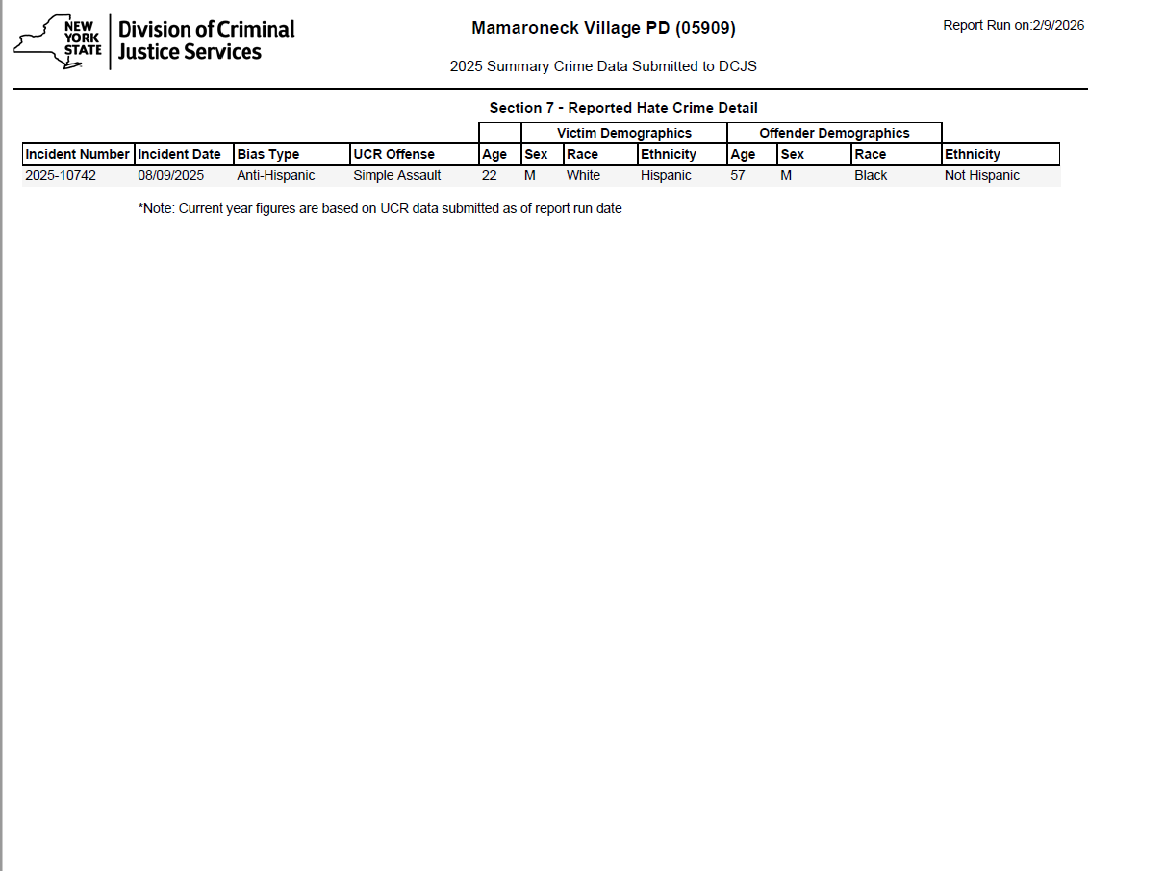
Hate Crimes reported to VMPD in 2024-2025

Slide 17
2024-2025 Addendum: Catalytic Convertors Stolen Cases
2024
3
2025
0
100% Decrease

Slide 18
2024-2025 Addendum: Vehicle Break- ins (VBI)
2024
17
2025
2
88% Decrease
Please emphasize to residents:
Remove anything of value from your car
Lock your Car
Do not leave key fobs in your car

Slide 19
2024 Addendum: Stolen Check Cases
2024
125
2025
16
87% Decrease
Please emphasize to residents:
Please pay your bills online
Do not mail out checks
If you do mail out checks, please use a gel pen to write on the check.

Slide 20
2018-2025 Finger-printable only Arrests by Race and Ethnic Origin

Slide 21
2021-2025 All Arrests by Race and Ethnic Origin

Slide 22
2021-2025 All VMPD Arrests

Slide 23
2024-2025 Reported Offenses & Arrests
2024 Reported Part I Offenses 267
2024 Reported Part II Offenses 282
Total: 549
2024 Reported Arrests Part I &II 317
2024 Reported Arrests Non-UCR 321
2024 Total Arrests (UCR Part I & II & Non-UCR) 638
2025 Reported Part I Offenses 118
2025 Reported Part II Offenses 205
Total: 323
2025 Reported Arrests Part I &II 186
2025 Reported Arrests Non-UCR 545 41% increase
2025 Total Arrests (UCR Part I & II & Non-UCR) 731

